Slide 1

Workshop #3
UART Chat Program

Slide 2
UART Chat Program
Sending messages between Arduinos via a UART serial connection
JD Smith, Kenneth Justice

Slide 3
Serial Communication
Packets of data are sent through one wire sequentially, one bit at a time.
Is clocked at a speed which both the transmitting and receiving device agree upon (Called the baudrate).
This is as opposed to parallel communication, which uses multiple wires to deliver multiple bits at once, which is quicker but requires more wires.

Slide 4
UART
Universal Asynchronous Receiver-Transmitter
Integrated hardware device (not a protocol) which can receive and transmit data through two serial connections.
Two pins per device (RX/TX)
For each transmit and receive pin there is a shift register.
Transmission is clocked based on the baudrate (Bits per second in the case of UART).
Asynchronous, in that either device can transmit data at any given time.
Two UART devices must agree on a baudrate and packet structure.

Slide 5
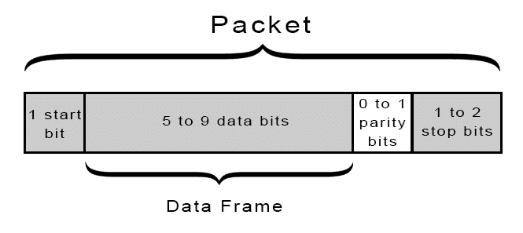
Packet Structure
A UART packet will have
One start bit to indicate the beginning of a packet.
5-9 data bits (In our case, it will be 8 bits or 1 byte for ASCII characters)
0-1 parity bits to check for errors.
1-2 stop bits to indicate the end of the packet.
Image Source: https://www.circuitbasics.com/basics-uart-communication/

Slide 6
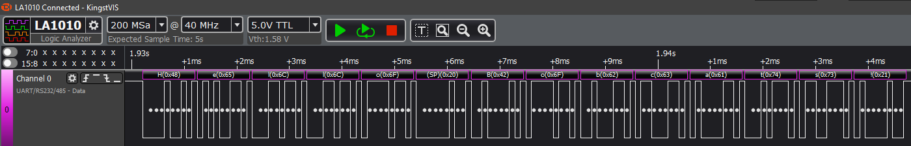

Slide 7
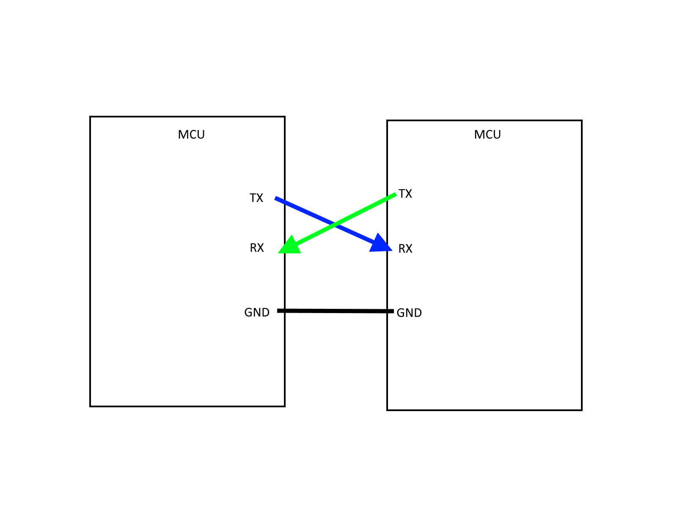

Slide 8
Special Thanks To…
Kenneth Justice, for writing the chat program sketch and demonstrating it for this workshop.

